Slide 1
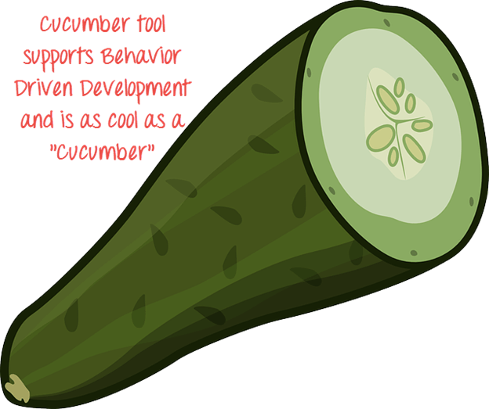
July 2018

Slide 2
Behavior Driven Development
It gives us an opportunity to create test scripts from both the developer’s and the customer’s perspective as well. So in the beginning, developers, project managers, QAs, user acceptance testers and the product owner (stockholder), all get together and brainstorm about which test scenarios should be passed in order to call this software/application successful
July 2018

Slide 3
CUCUMBER
Cucumber is a open source tool, which supports behavior driven development. To be more precise, Cucumber can be defined as a testing framework, driven by plain English text. It serves as documentation, automated tests, and a development aid – all in one.
Cucumber runs automated acceptance tests written in a behavior-driven development style.
Central to the Cucumber BDD approach is its plain language parser called Gherkin.
It allows expected software behavior to be specified in a logical language that customer can understand.
As such, Cucumber allows the execution of feature documentation written in business facing text.
July 2018

Slide 4
Gherkin Language
Gherkin is a plain English text language, which helps the tool - Cucumber to interpret and execute the test scripts. It is a domain specific language which helps you to describe business behavior without the need to go into detail of implementation. This text acts as documentation and skeleton of your automated tests. All Gherkin files have .feature file extension.
Annotation is a predefined text, which holds a specific meaning. It lets the compiler/interpreter know, what should be done upon execution. Cucumber has got the following few annotations −
Feature - List of scenarios.
Background - List of steps run before each of the scenarios
Scenario - Details about the scenario under the test
Scenario Outline - basically replaces variable/keywords with the value from the table. Each row in the table is considered to be a scenario.
Examples - Container for test data
Given - It describes the pre-requisite for the test to be executed.
When - It defines the trigger point for any test scenario execution.
Then - It defines expected result for the test to be executed.
And/But - It provides the logical AND condition between any two statements. AND can be used in
conjunction with GIVEN, WHEN and THEN statement.
Tag - To Group specific scenarios
July 2018

Slide 5
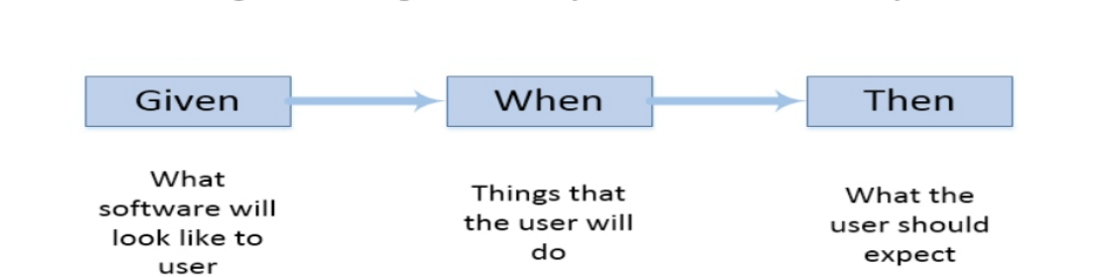
July 2018

Slide 6
Thought Leadership Initiative – UI Test Automation
Scope Definition
What is the scope of the topic?
To provide guidance on bringing teams up to speed with Selenium/Cucumber automation
Factors to consider while Automating UI applications
1. Maven should be installed
2. All required dependencies should be included in POM.xml file
3. Cucumber plugin for Eclipse, TestNG and Natural plugin should be installed
4. Java JDK should be installed and configured

Slide 7
Thought Leadership Initiative – UI Test Automation
Scope Definition
What technologies will be researched / utilized?
Selenium Web driver ( JAVA)
Core JAVA
Eclipse IDE
Cucumber BDD Framework
Maven
TestNG
POI
Cucumber Extent Report
Jenkins

Slide 8
Thought Leadership Initiative – UI Test Automation
Project Setup and Dependencies
Configure JDK/JRE
Configure MAVEN
Install Eclipse IDE
Install Cucumber Eclipse Plugin, TestNG Plugin, Natural Plugin
Create Maven Project and add below dependencies
cucumber-core
cucumber-java
cucumber-html
gherkin
cucumber-jvm-deps
cobertura
mockito-all
cucumber-reporting
maven-cucumber-reporting
cucumber-extentsreport
extentsreport
hamcrest-all
cucumber-testing
testng
Selenium-server
Poi/poi-ooxml
webdrivermanager
maven-complier-plugin
maven-surefire-plugin

Slide 9
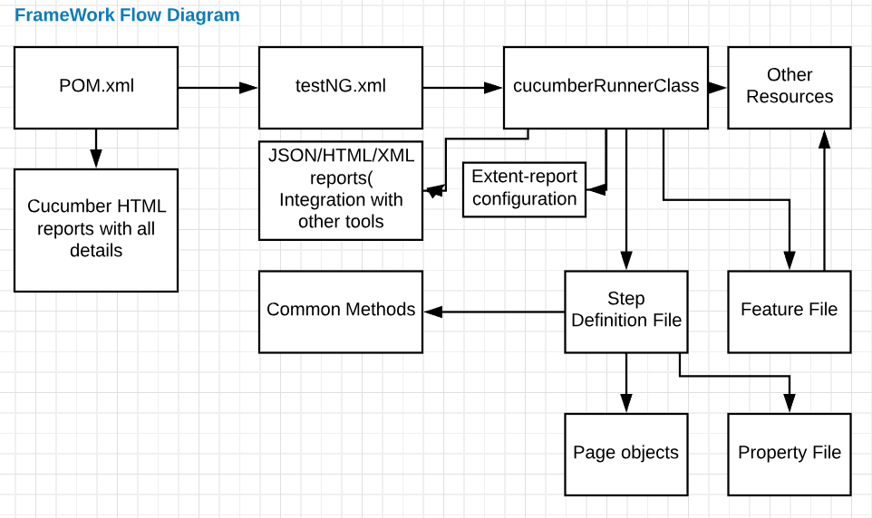
July 2018

Slide 10
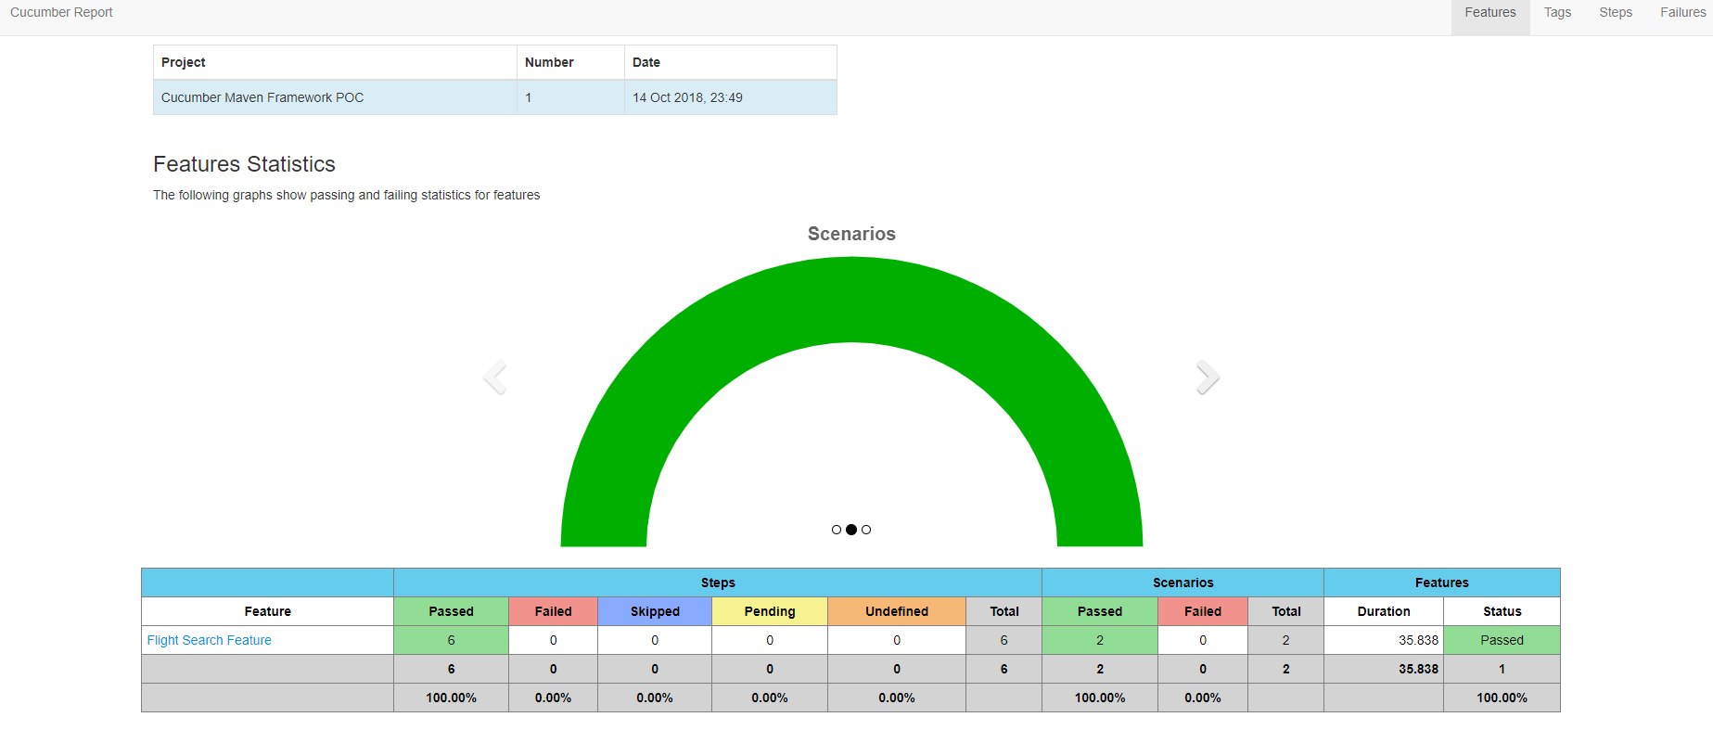
July 2018

Slide 11
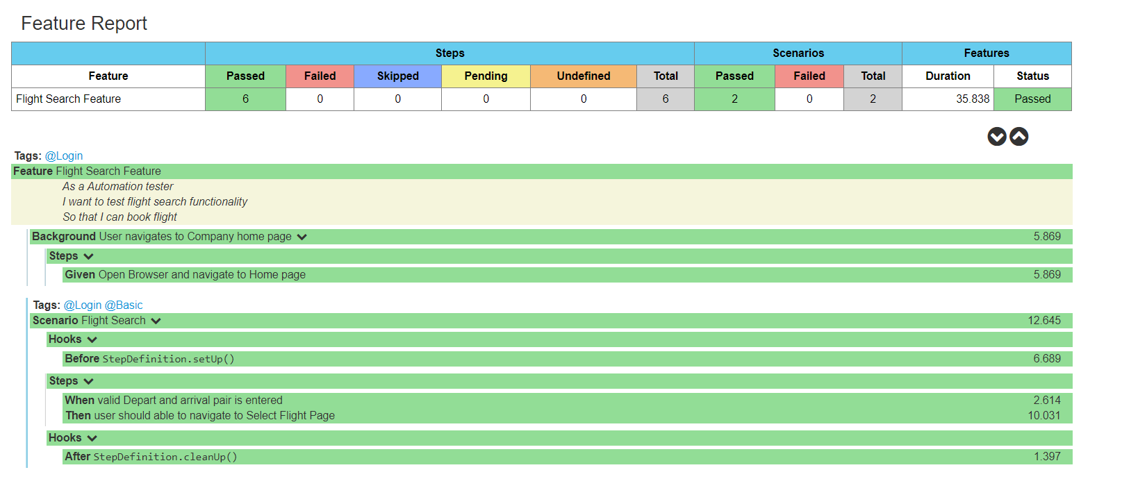
July 2018

Slide 12
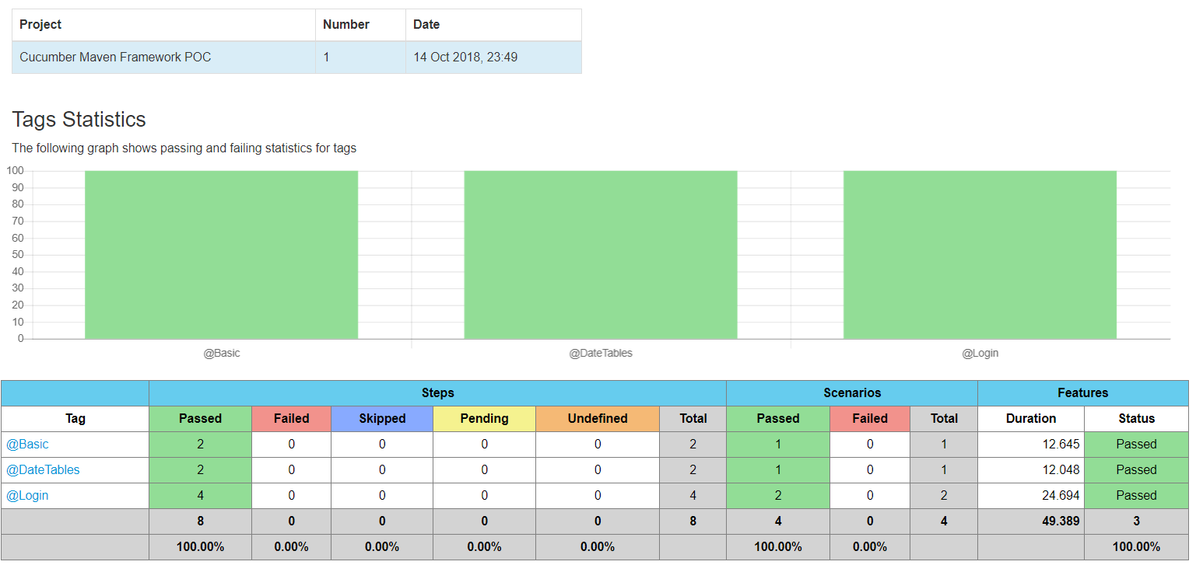
July 2018

Slide 13
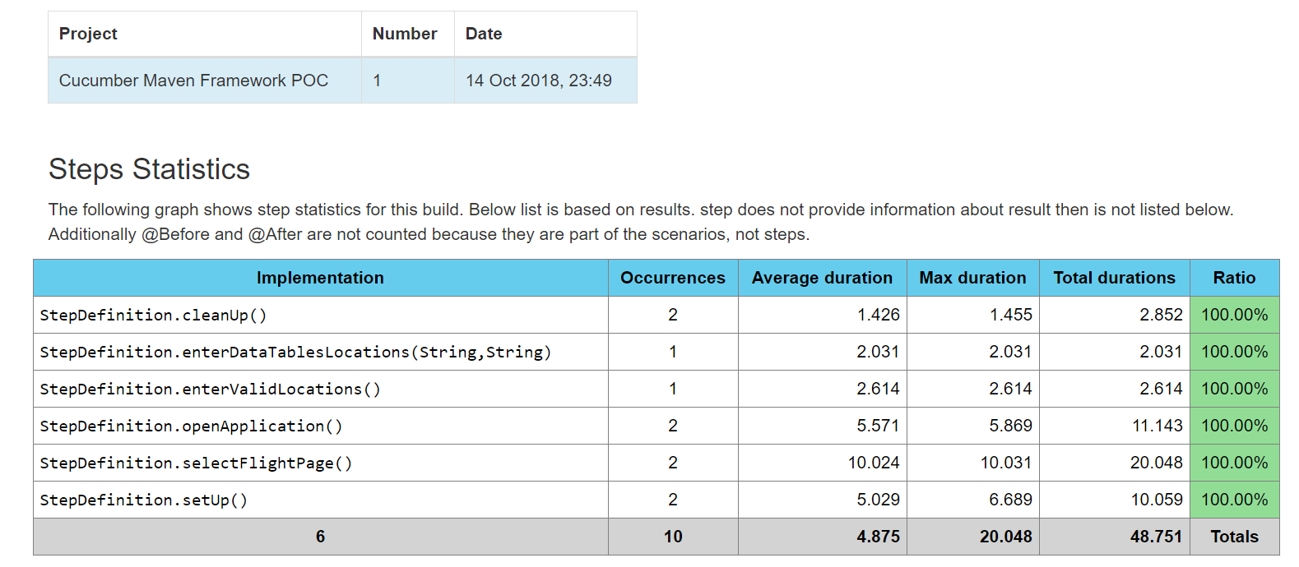
July 2018

Slide 14

July 2018

